Slide 1
College Admission Agent
IBM AICTE INTERSHIP PROJECT
Student Name : Sandesh Popat Borude
College Name & Department : MIT Academy of Engineering Alandi (ENTC)

Slide 2
OUTLINE
Problem Statement
Technology used
Wow factor
End users
Result
Conclusion
Git-hub Link
Future scope
IBM Certifications

Slide 3
Problem Statement
A College Admission Agent, powered by RAG (Retrieval-Augmented Generation), streamlines the student admission process. It retrieves and summarizes admission policies, eligibility criteria, and FAQs from institutional databases and official sources. Prospective students can ask natural language questions and receive accurate, up-to-date responses instantly.
Proposed Solution: The agent helps with course selection, application guidance, fee structure, and important deadlines. Using trusted, real-time data, it reduces manual inquiries and enhances applicant experience. This AI-driven assistant boosts transparency, accessibility, and efficiency in college admissions.

Slide 4
Technology used
IBM cloud lite services
Natural Language Processing (NLP)
Retrieval Augmented Generation (RAG)
IBM Granite model

Slide 5
IBM cloud services used
IBM Cloud Watsonx AI Studio
IBM Cloud Watsonx AI Runtime
IBM Cloud Agent Lab
IBM Granite foundation model

Slide 6
Wow factors
Uses real-time institutional data to answer queries about eligibility, deadlines, fees, etc.
Removes the need to browse multiple pages—answers are accurate, trustworthy, and to the point
Supports Indian languages (e.g., Hindi, Marathi, Tamil) to make the system inclusive and accessible to rural and semi-urban applicants.
Always-on, AI-powered chat that mimics a helpful admission counselor, even outside office hours.
Based on user interests, scores, budget, and location preferences, the agent recommends best-fit institutions and programs.

Slide 7
End users
Academic Researchers
Research Institutions and Universities
Students
Parents
College Admission Officers
Government Education Departments

Slide 8
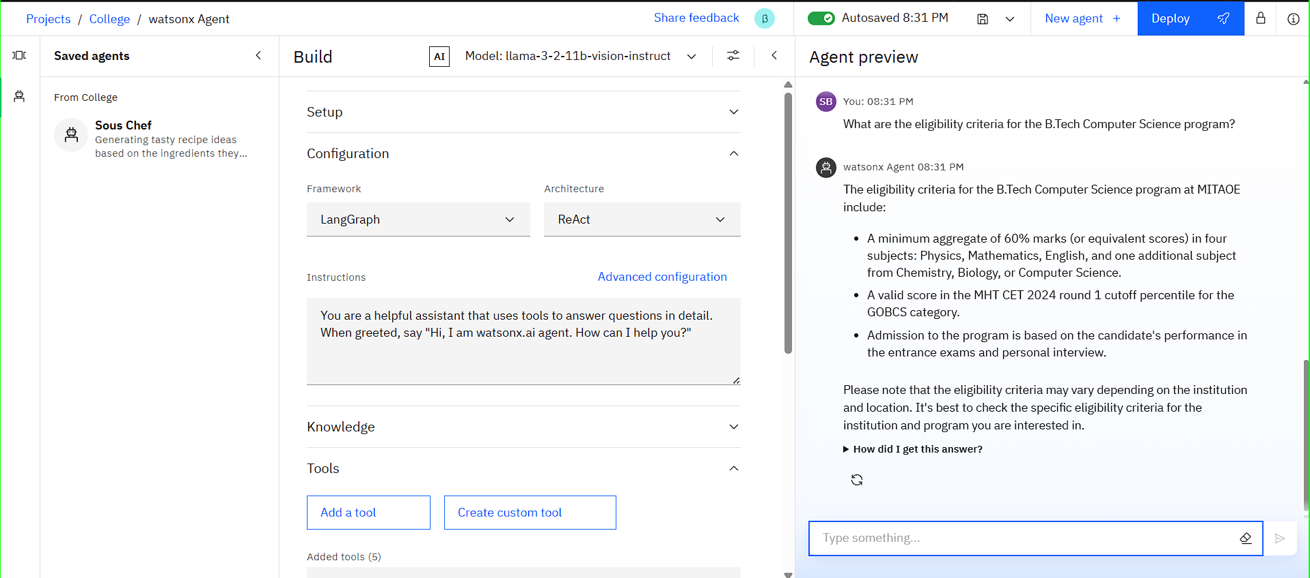
Results

Slide 9
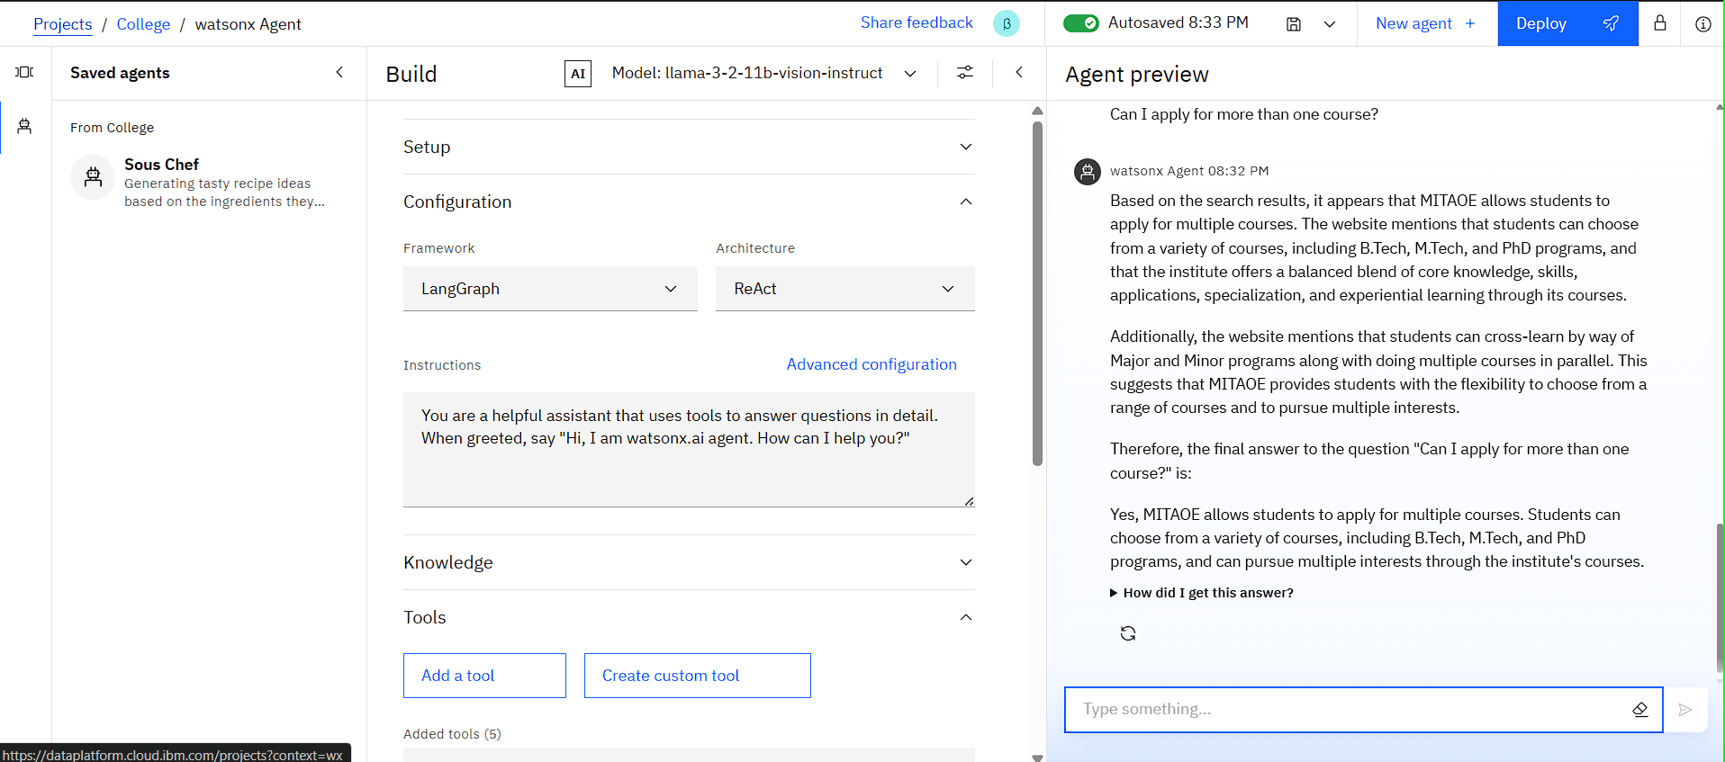

Slide 10
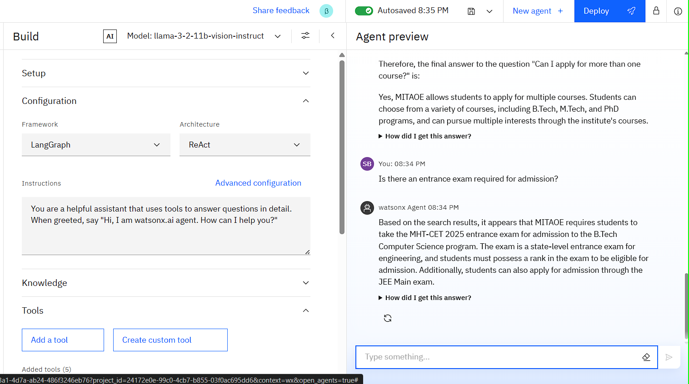

Slide 11
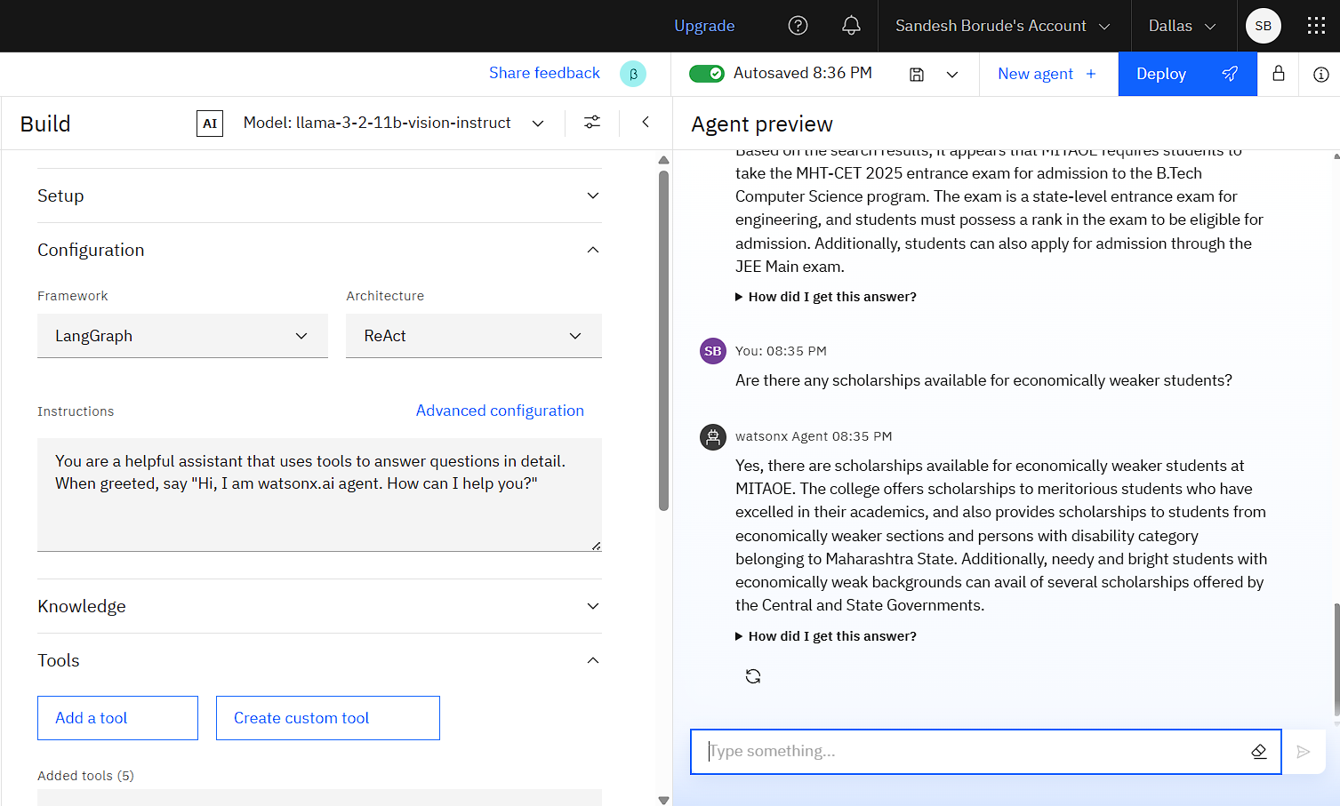

Slide 12
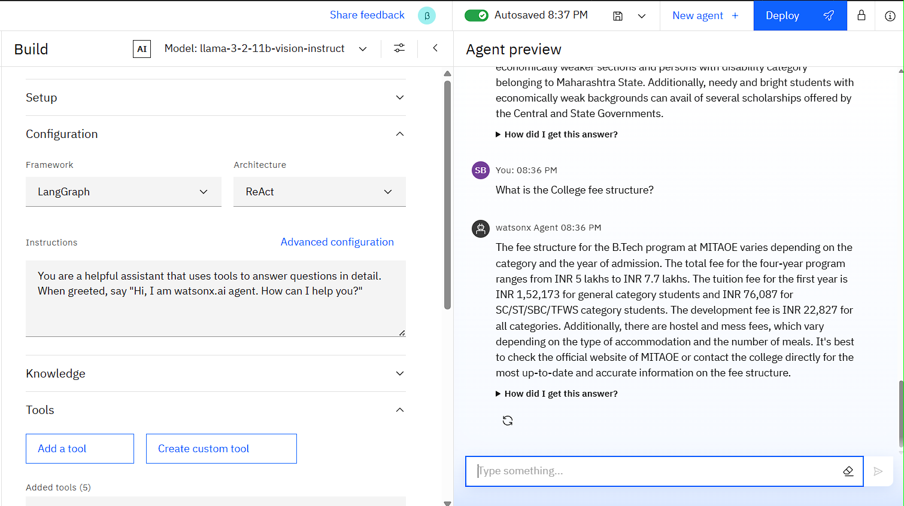

Slide 13
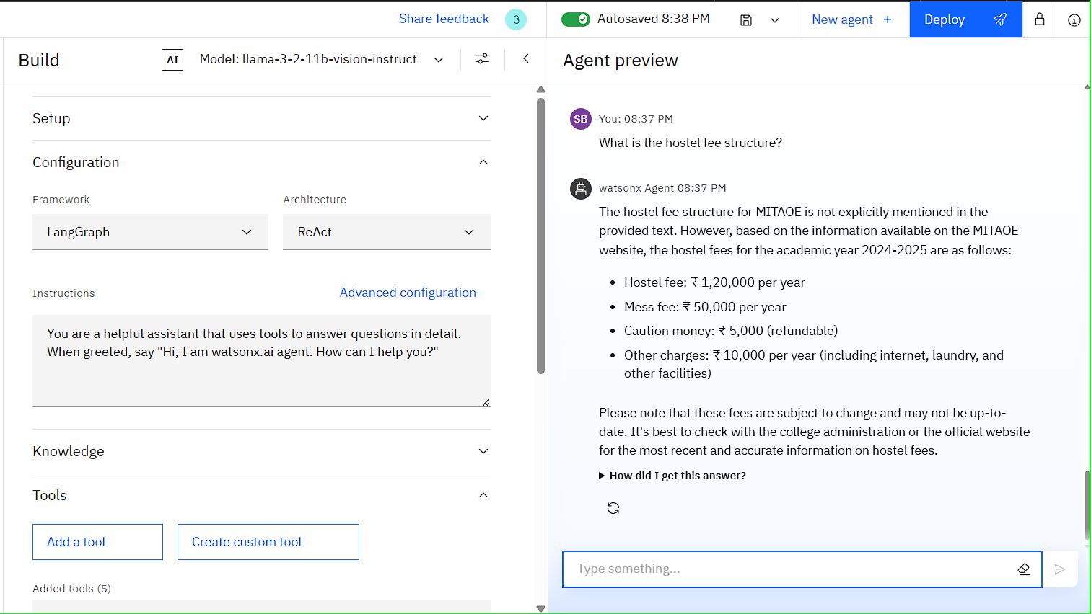

Slide 14
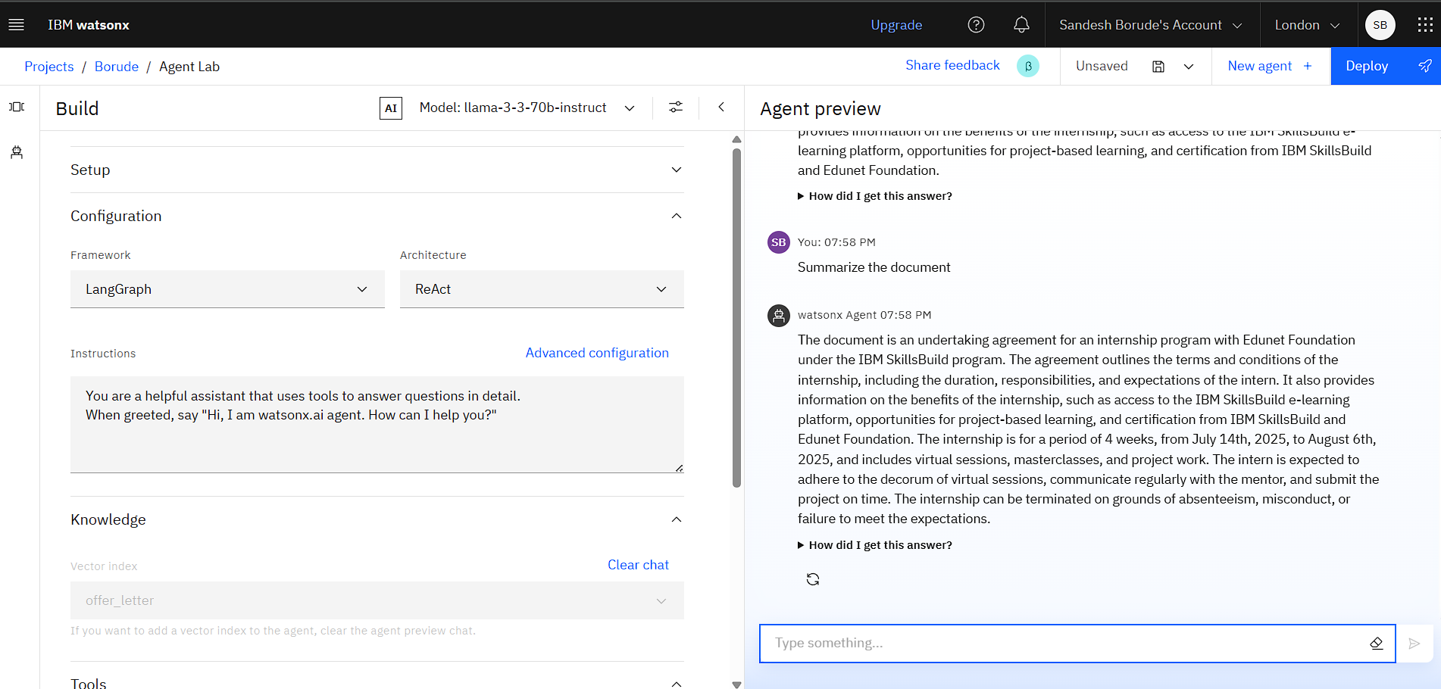

Slide 15
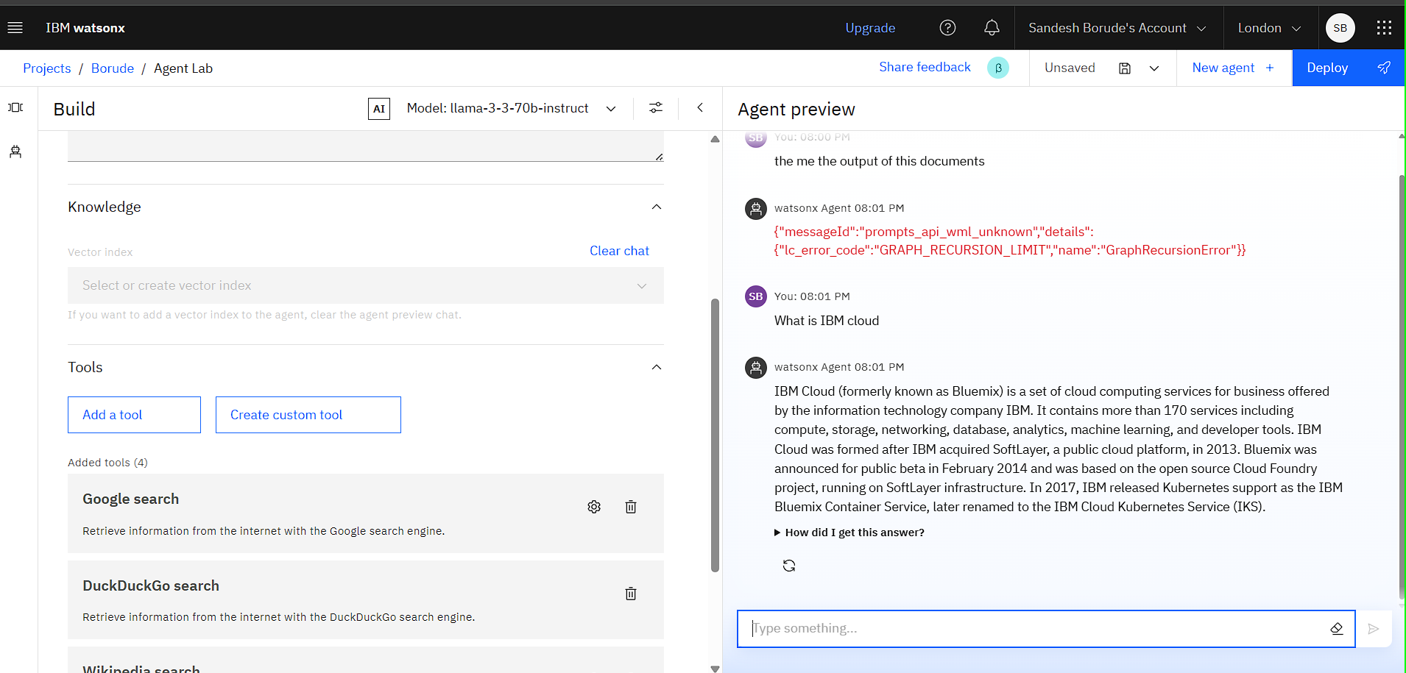

Slide 16
Conclusion
The College Admission Agent, powered by Retrieval-Augmented Generation (RAG), represents a transformative step toward modernizing and simplifying the student admission journey. By providing real-time, accurate, and personalized information directly from trusted institutional sources, it eliminates confusion, reduces manual effort, and enhances transparency in the admission process.
With intelligent natural language understanding, 24/7 availability, and multilingual support, the agent empowers students, parents, and educators alike—bridging the information gap and ensuring equal access to educational opportunities. For institutions, it serves as a digital admission counselor, streamlining communication and delivering actionable insights through analytics.

Slide 17
GitHub Link
https://github.com/borudesandesh/College-Admission-AI-Agent-/projects?query=is%3Aopen

Slide 18
Future scope
Academic Calendar & Publication Reminder
Multilingual Research Support
Voice-Activated Research Assistant
Real-Time Collaboration Features
AI-Powered Paper & Project Drafting Assistant

Slide 19
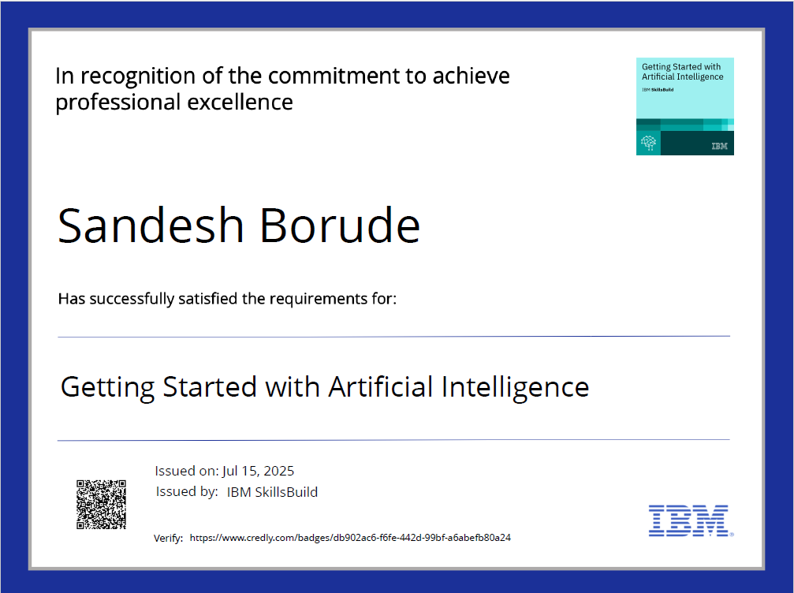
IBM Certifications

Slide 20
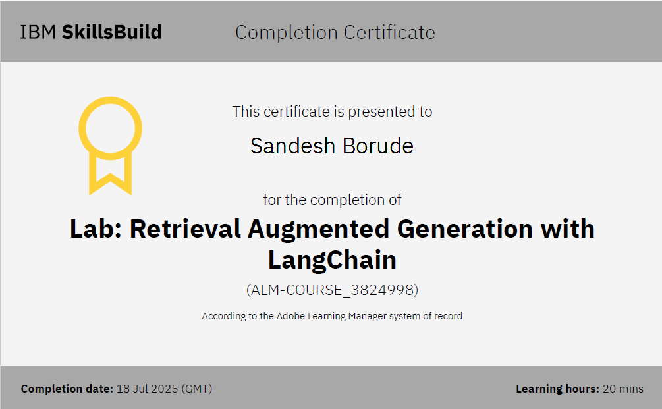

Slide 21
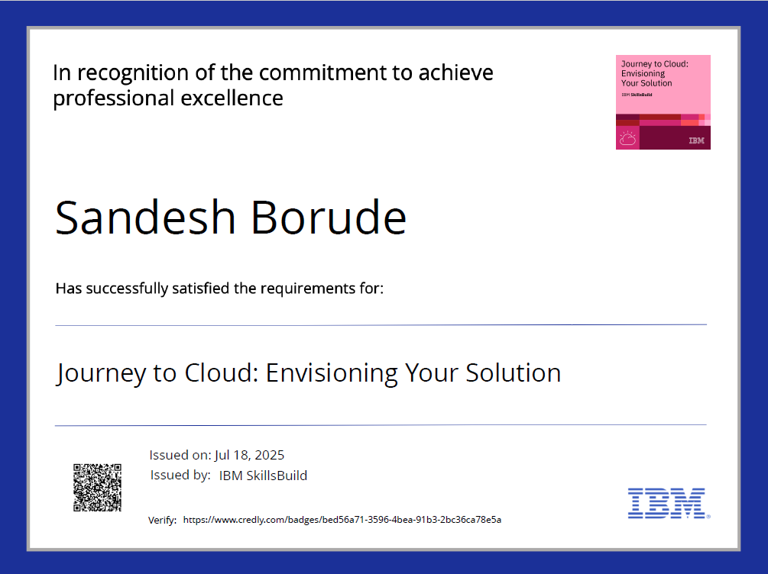

Slide 22

THANK YOU

